Slide 1
PROJECT LOG
JUNIFA , WEI SI, AMSYAR, ZHEN YANG

Slide 2
Action Problem Statement
Unsatisfied students need to have more enjoyment, pleasure and excitement because they feel school is not a place for interaction.

Slide 3
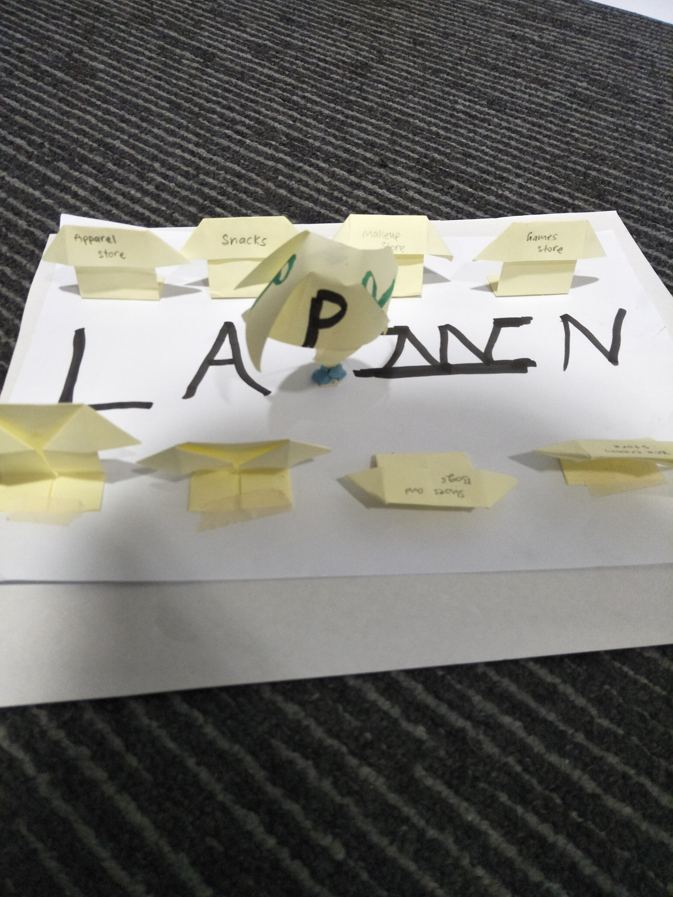
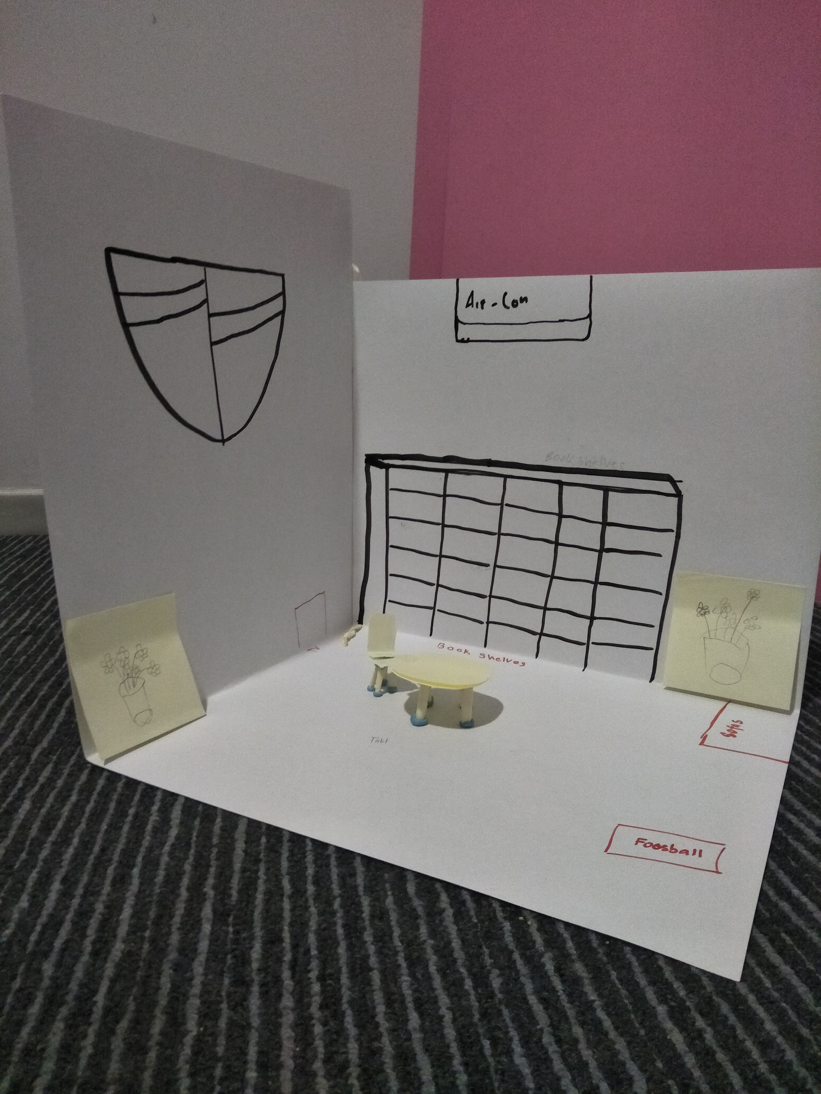
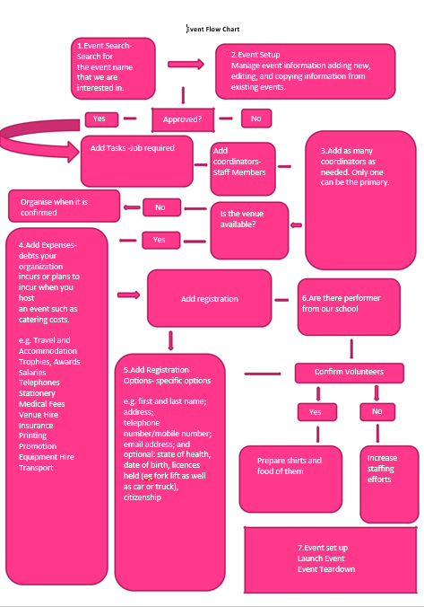
Prototypes
Music Filled Events
Flea Market - Cardboard
Recreation room - Mahjong Oaoer

Slide 4
Prototypes
Prototype | User feedback | Changes made in response to feedback | Test Prototype (Y/N)
Recreation Room - Mahjong paper | 1. Music would be great furniture selection must decent. 2. Consider also adding warmth to the space by installing a some form of carpeting, and adding a lighting design that will highlight specific areas the pool table area | No changes made. We did not choose this prototype because many students that we surveyed also told us that they might not to use the facility. Hence, the investment is greater than the outcome which defeats the purpose. | N

Slide 5
Prototypes
Prototype | User feedback | Changes made in response to feedback | Test Prototype (Y/N)
Music Filled Events - Flow Chart | 1. Ensure it is a good Event name 2. Take to social media 3. Launch a campaign at the same time 4. Sponsor gifts | No changes made. We did not choose this prototype because there were many challenges such as there was no budget to upgrade our presentation technology to create more professional planning and the group only has one person with experience in managing events. | N

Slide 6
Prototypes
Prototype | User feedback | Changes made in response to feedback | Test Prototype (Y/N)
Flea Market - Cardboard | 1. The easier you make it for shoppers to buy, the more they're likely to spend, especially if you sell big-ticket items like furniture. | We chose this prototype because this prototype sparked the most anticipation and interests . The changes to the prototype made include: ● Improving finishing options for the end product ● Adding more features to maintain fidelity ● Flows instead of a set of pages(Flowchart) | Y

Slide 7
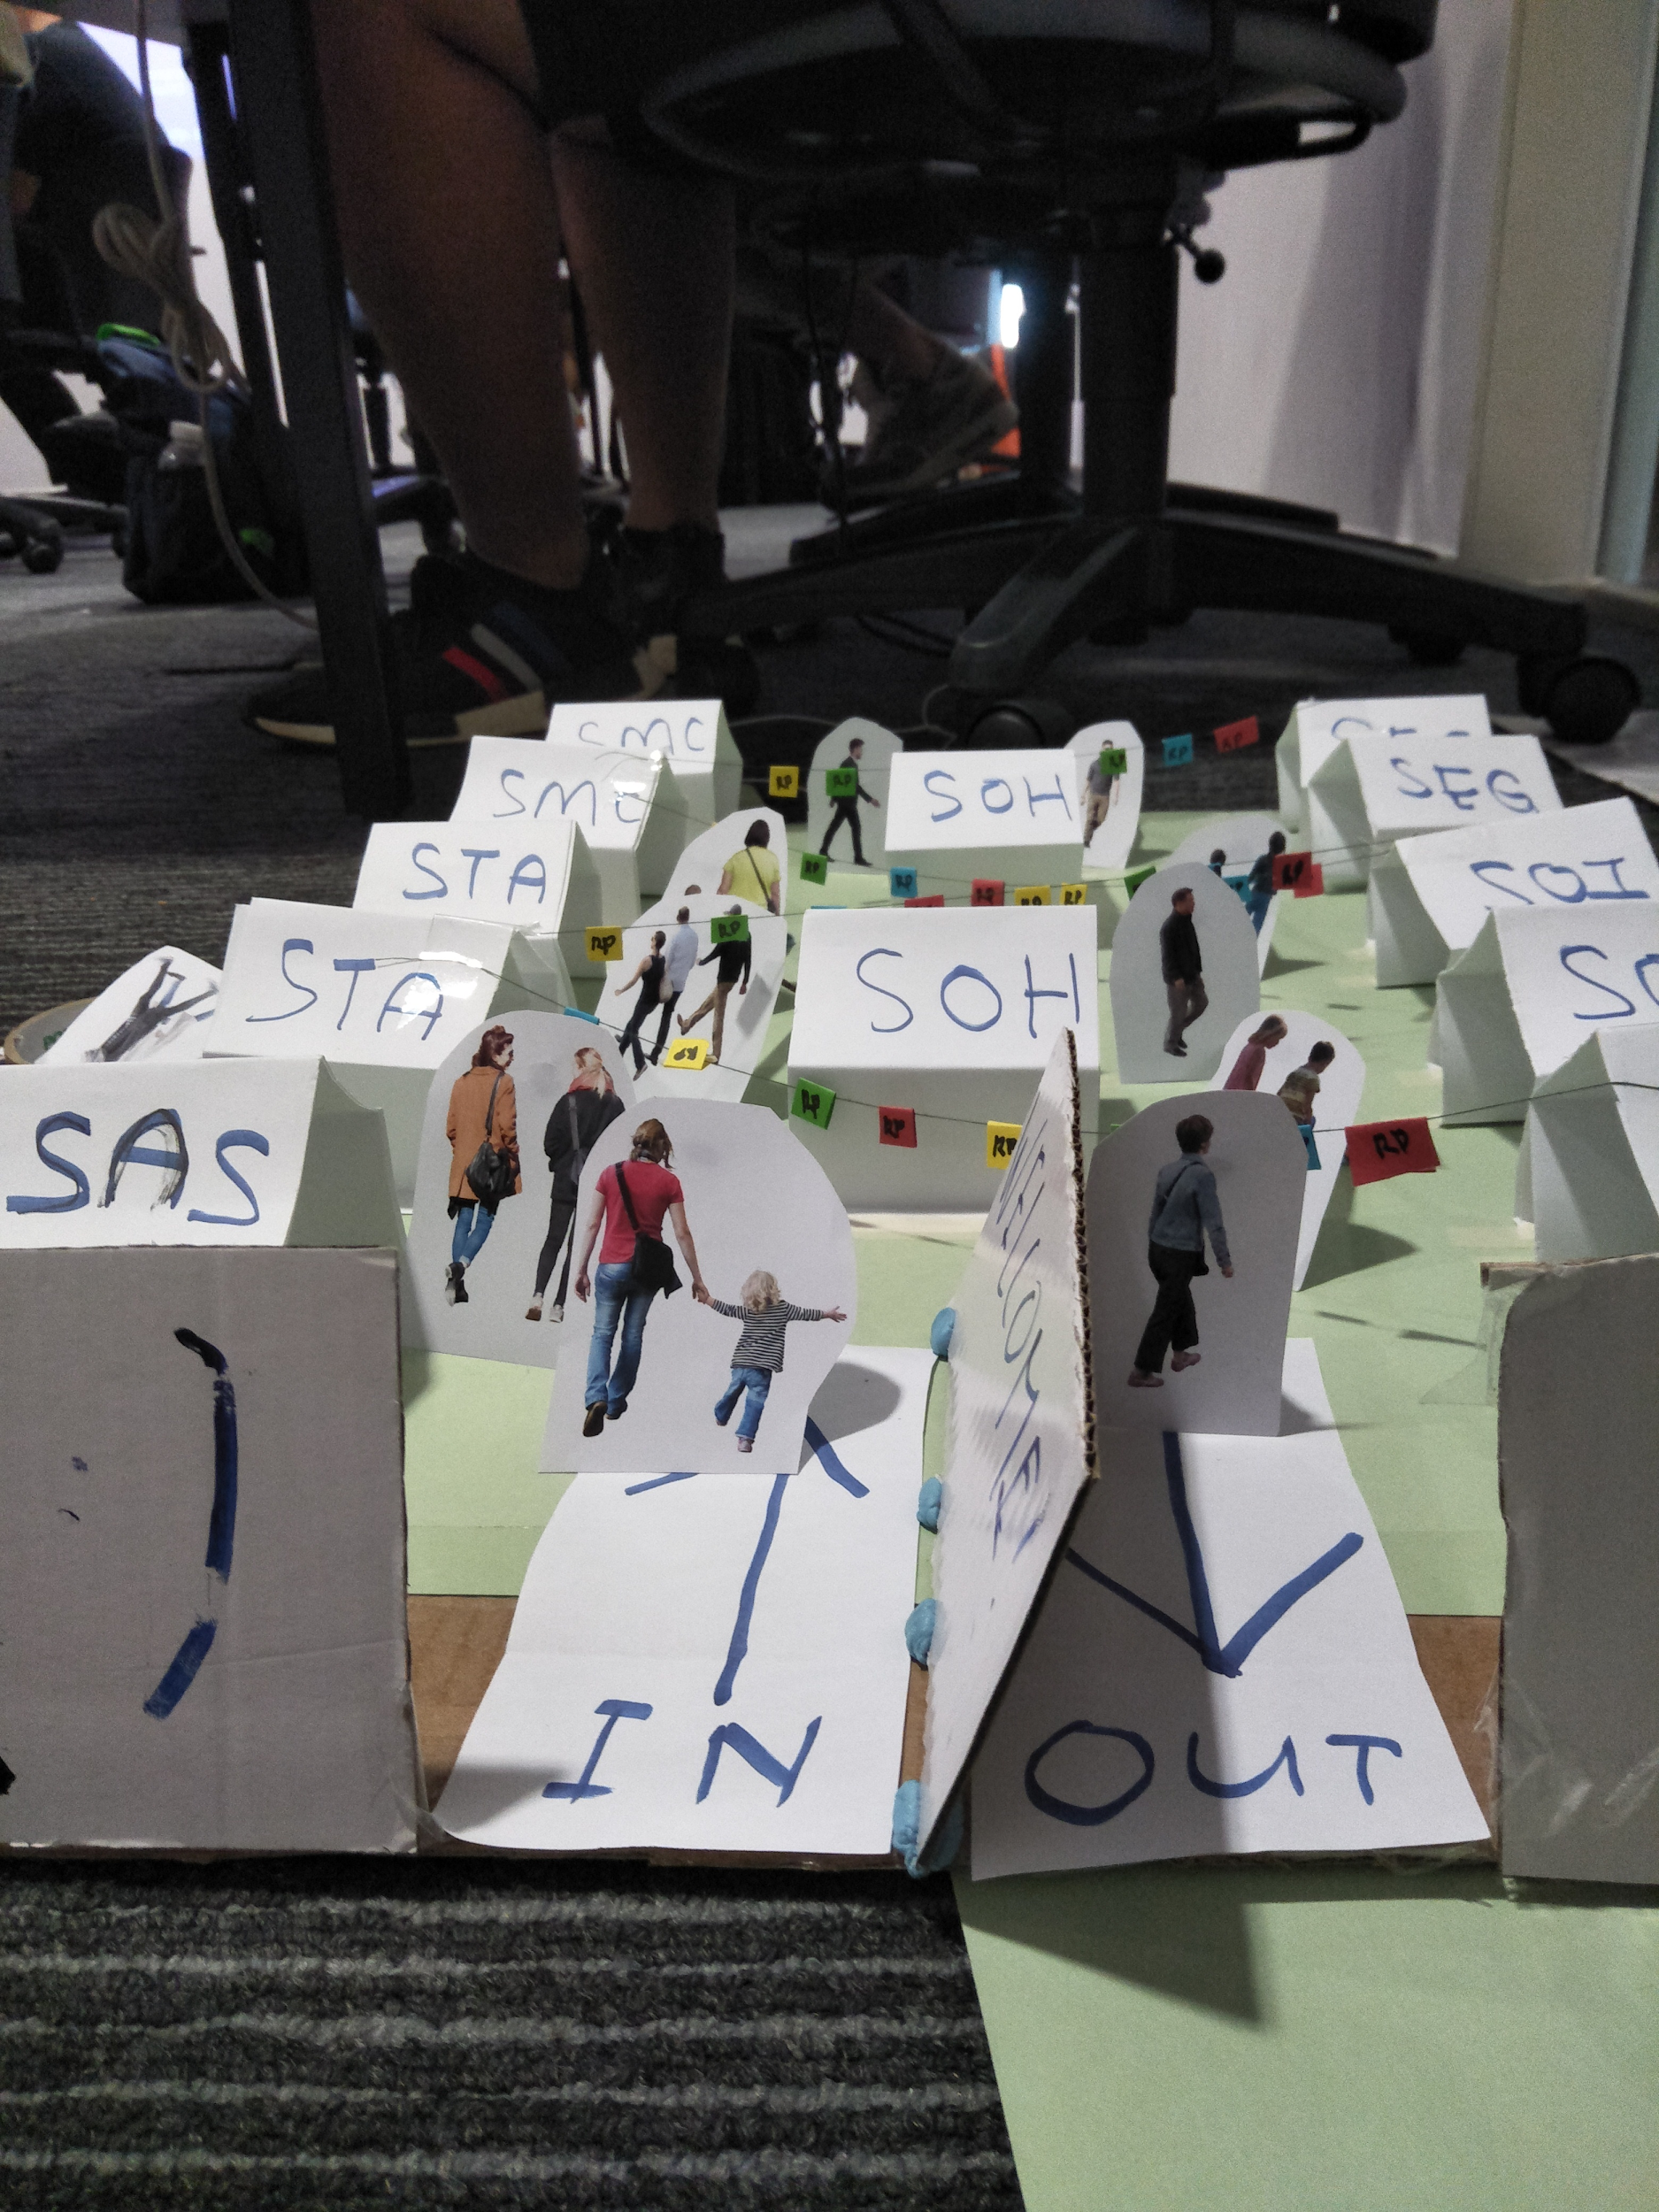
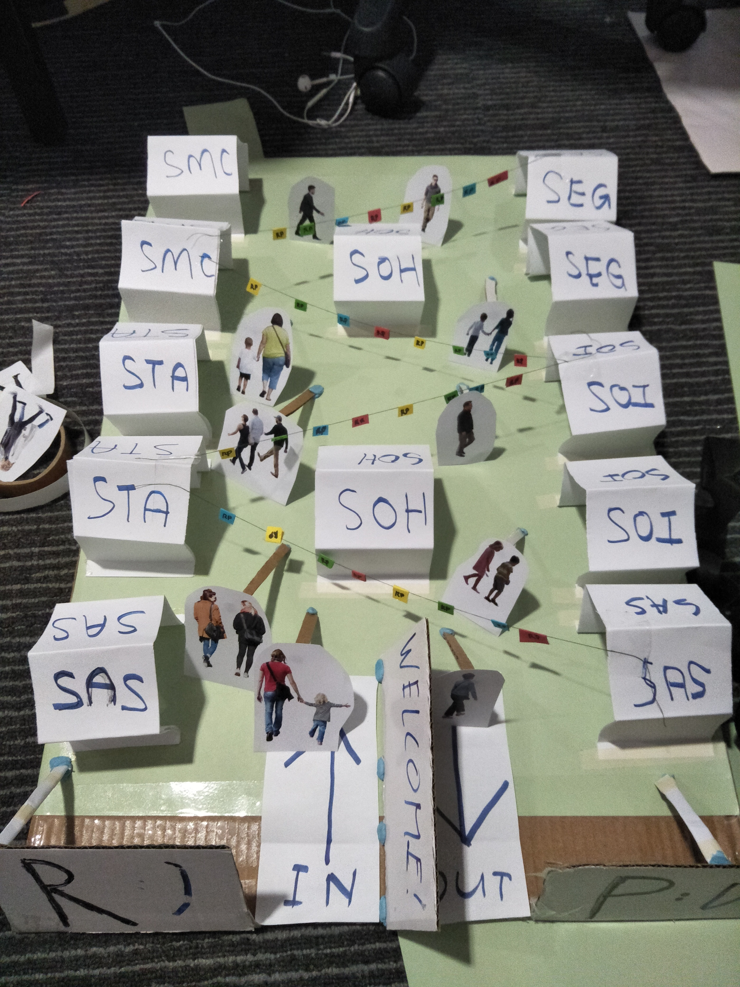
HIGH RES PROTOTYPE

Slide 8
HIGH RES PROTOTYPE(FLOWCHART)

Slide 9
SURVEY QUESTIONS
Gender
Age
Did you like our prototype?
What did you like most or dislike most about our prototype?
Do you have any suggestions that can improve our prototype?
Do you have any suggestions for improvements to our flowchart?

Slide 10
Sample Result
Gender M
Age 16
Did you like our prototype? Yes.
What did you like most or dislike most about our prototype? Decoration. I think they shouldnt group the schools together, because it allows better communication between all the schools.
Do you have any suggestions that can improve our prototype? No, i dont think so.
Do you have any suggestions for improvements to our flowchart?

Slide 11
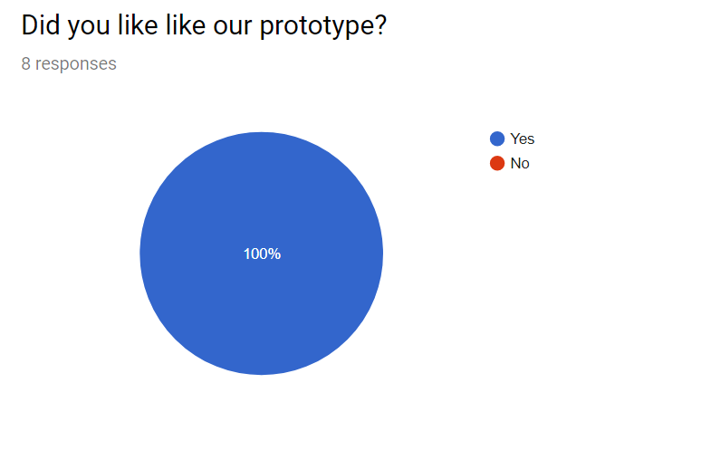
Overall Results

Slide 12
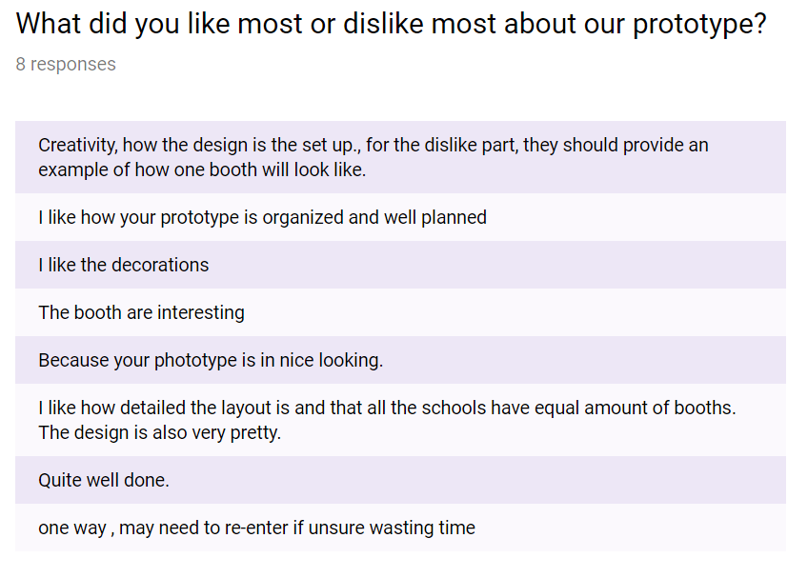

Slide 13
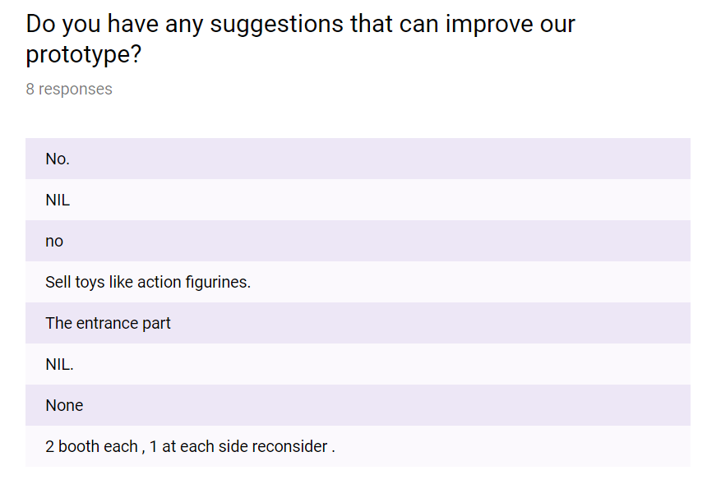

Slide 14
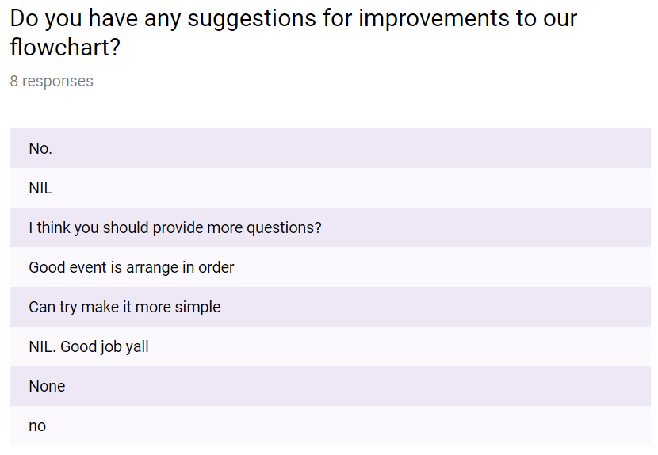

Slide 15
ANALYSIS OF FEEDBACK
Number of people being surveyed: 8
Age group:16-18(37.5%) Above 18(62.5%)
Number of positive responses: 8
Number of negative responses: 0

Slide 16
MODIFICATIONS)
Based on our results, we will not make any modifications to the event itself but we will make modifications to the planning in the flowchart
Improve the security measures
Collect registrant info online.
Engage them via mobile.
Go hybrid(Add various technologies)
Collect feedback at the end of the event

Slide 17
UNINTENDED CONSEQUENCES
Participant dropouts
No one shows up
Vendor lose money
Technology failure
Unexpected weather
Epic queues

Slide 18
Conclusion
We have learned that Design Thinking:
Gives you the opportunity to view a problem from a different perspective.
Allows you to delve into a problem to determine its root cause.
Encourages innovative thinking and creative problem solving.
Ensures that the outcome meets objectives and client requirements.
Results in an experience that is more effective and informative for your learners.

Slide 19
Thank You! ☺

